Slide 1



IPRC NGOMA
Integrated Polytechnic Regional College
P.O. Box35 KIBUNGO - RWANDA
Tel: +250 785883746
Email: info@iprcngoma.rp.ac.rw
Website: www.iprcngoma.rp.ac.rw
MODULE CODE: ITLES801
MODULE TITLE: Embedded System Development
Class: B-Tech of IT
MEMBERS:
23RP00761
23RP01617
23RP01381
Group 6
Homework 1

Slide 2
TOPIC OF THE SESSION
Discuss on different components of embedded system
ES

Slide 3
Objectives: By the end of this session the learner should be able to:
Explain clearly microcontroller as used in Embedded System.
Identify appropriately the components of microcontroller as used in Embedded System.
Clarify efficiently some components of embedded system as used in Technology.
ES

Slide 4
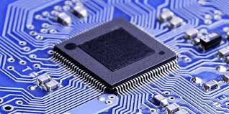
A microcontroller (MCU) is a single integrated circuit that is designed to control specific tasks within electronic systems. It combines the functions of a central processing unit (CPU), memory, and input/output interfaces, all on a single chip.
Q1 a)
Microcontroller
Microcontroller
Key components of a microcontroller include:
1. Processor Core: This executes instructions and performs calculations.
2. Memory: Typically, microcontrollers have two main types of memory: RAM for temporary data storage and ROM or flash memory for storing the program or firmware.
3. Peripherals: These are additional integrated components that offer functionalities such as input/output (I/O) ports, timers, analog-to-digital converters (ADCs), serial communication interfaces (UART, SPI, I2C), PWM (Pulse Width Modulation), and more. These peripherals enable the microcontroller to interact with the external environment.
ES

Slide 5
Cont~
The microcontroller used in Embedded System. for example: • Security Systems • Laser Printers • Automation System • Robotics, etc.
Types of Microcontroller
a) 8-bit Microcontrollers: typically used in simple applications such as toys, small appliances, and remote controls. They have a limited processing power and memory capacity, but they are easy to use and cost-effective.
Microcontroller
ES

Slide 6
b) 16-bit Microcontrollers: These are more advanced than 8-bit microcontrollers and are capable of performing more complex tasks. They are commonly used in applications such as medical devices, automotive systems, and industrial control systems.
c) 32-bit Microcontrollers: These are the most powerful and feature-rich microcontrollers, capable of handling large amounts of data and performing high-speed processing. They are used in applications such as gaming systems, multimedia devices, and high-end industrial automation.
d) ARM Microcontrollers: Is based on the ARM architecture and are widely used in a variety of applications, including mobile devices, automotive systems, and industrial control systems.
Cont~
Microcontroller
ES
ARM: Advanced RISC Machine

Slide 7
e) PIC Microcontrollers: These microcontrollers are manufactured by Microchip Technology and are commonly used in a wide range of applications, including home appliances, automotive systems, and medical devices.
f) AVR Microcontrollers: These microcontrollers are manufactured by Atmel Corporation and are commonly used in applications such as robotics, industrial control systems, and consumer electronics.
g) FPGA-based Microcontrollers: Used to provide highly customizable and flexible processing capabilities. Used in applications such as digital signal processing, video processing, and high-speed networking.
Cont~
Microcontroller
ES
ARM: Advanced RISC Machine AVR: Automatic Voltage Regulator
FPGA: Field Programmable Gate Array PIC: Peripheral Interface Controller

Slide 8
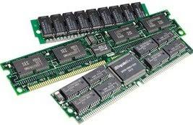
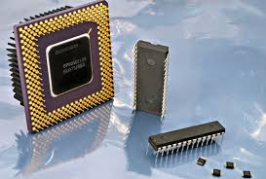
b) Memory
RAM
Memory: refers to the electronic component used to store data temporarily or permanently. There are different types of memory within a microcontroller, each serving distinct purposes:
RAM (Random Access Memory): RAM is volatile memory used for temporary data storage during program execution. It allows the microcontroller to read from and write to it, providing fast access to data. However, it loses its content when the power is turned off.
ROM (Read-Only Memory): ROM stores data or instructions that are permanently written during the manufacturing process and cannot be altered by normal program execution. Some microcontrollers use flash memory, which is a type of re-writable ROM, allowing the stored data to be changed or updated.
ROM
ES

Slide 9
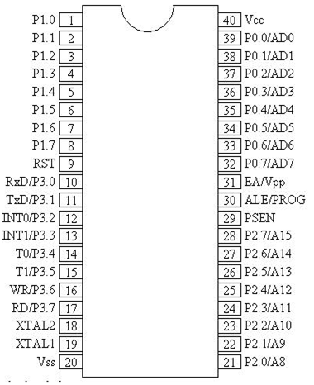
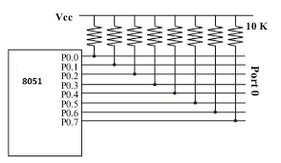
c) Input/output ports
Input/output (I/O) Ports: These ports enable communication between the microcontroller and external devices, allowing it to receive input from sensors and send output to control various components like LEDs, motors, or displays.
I/O Ports and their Functions. The four ports P0, P1, P2, and P3, each use 8 pins, making them 8-bit ports. Upon RESET, all the ports are configured as inputs, ready to be used as input ports. When the first 0 is written to a port, it becomes an output.
ES

Slide 10
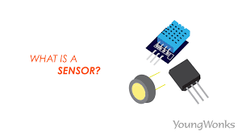
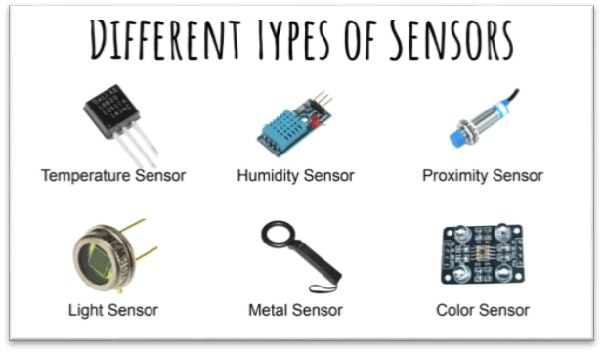
Sensors: Devices that detect and respond to changes in the physical environment. Sensors are essential components of embedded systems that enable them to interact with the physical world
They include temperature sensors, motion sensors, light sensors, and more, allowing the microcontroller to gather data from its surroundings.
d) Sensors
ES

Slide 11
Disadvantages of Sensors:
Sensors may be expensive depends on their functions.
Sensors can want to be covered from bodily harm.
Sensors also require ordinary adjustment to make certain accuracy.
Sensors might also have controlled ranges.
Sensors may not be appropriate for all environments, as a few sensors may not be capable of facing up to excessive ranges of moisture or dust.
Sensors also enhance privacy issues if they're used to collect non-public records, together with area or biometric information.
Cont~
Advantages of Sensors:
Sensors can computerize responsibilities and growing performance and accuracy.
Sensors used to monitor situations and collect records in real-time, and knowledgeable choice-making.
Sensors used to monitor and manipulate structures remotely, permitting operation and maintenance.
Sensors used to enhance protection by detecting the presence of human beings or items in dangerous regions.
Sensors used to preserve resources, adjust the construction temperature based totally on occupancy or turn off lighting while a room isn't in use.
Sensors enhance the exceptional of merchandise and services, for instance, by tracking the exceptional of the air or water.

Slide 12
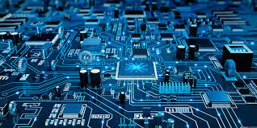
e) Electronic and Electromechanical components
Electronic component is a device in an electrical system that controls the flow of electrons in the circuit.
Electronic and Electromechanical Components Microcontrollers interact with various electronic components like transistors, resistors, and capacitors, as well as electromechanical components such as motors, relays, LEDs, etc., to perform specific tasks.
Electronic describes machines and devices that require electrical currents to run, and that use microchips and transistors to direct that current. cars, computers, radios, televisions, phones, etc.
ES

Slide 13
Electronic Components and Their Function
Capacitors: Store electrical charge in an electrical field.
Diodes: Components that conduct electricity in only one direction.
Integrated Circuits or ICs: Merged into a chip or semiconductor; a whole system rather than a single component.
Magnetic or Inductive Components: These are Electrical components that use magnetism.
Network Components: Components that use more than 1 type of Passive Component.
Piezoelectric devices, crystals, resonators: Passive components that use piezoelectric. effect.
Resistors: Components used to resist current.
Semiconductors: Electronic control components with no moving parts.
Switches: Components that may be made to either conduct (closed) or not (open).
Terminals and Connectors: Components to make electrical connection.
Transistors: A semiconductor device capable of amplification.
Cont~

Slide 14
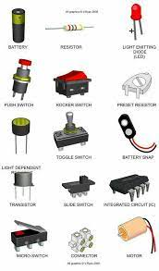
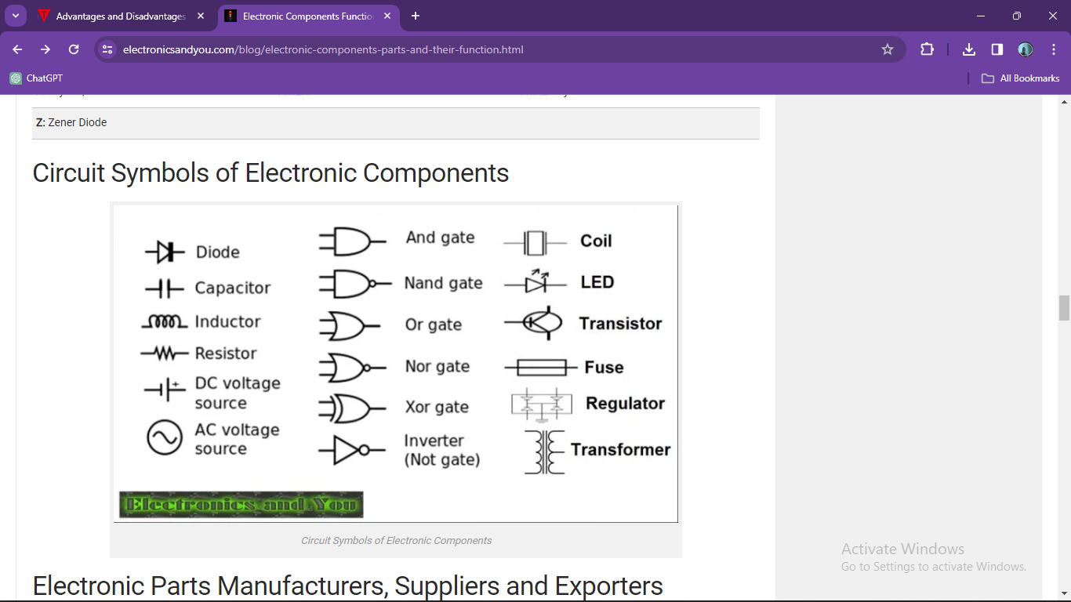
Cont~
Electronic and Electromechanical components some symbols and their names
ES

Slide 15
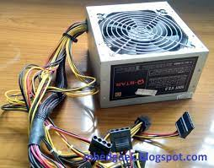
f)
Power Supply
An embedded system power supply has to provide voltages at all these levels across the entire system.
Power supplies for embedded systems normally must provide the primary input power at a standard voltage, and the power regulation strategy on the PCB provides power at the particular core voltages.
Three types of power supply?
linear, switched, and battery-based. Of the three basic regulated power supply designs, linear is the least complicated system, but switched and battery power have their advantages.
Power Supply
ES
PCB: Printed Circuit Board

Slide 16
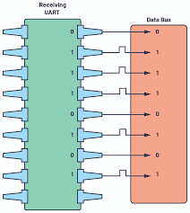
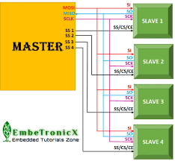
g) Communication interfaces (UART, SPI, I2C, Wi-Fi, Bluetooth, RF)
UART (Universal Asynchronous Receiver/Transmitter): Used for serial communication between the microcontroller and other devices. It facilitates the transmission and reception of data between two devices without the need for a clock signal to synchronize the communication process.
SPI (Serial Peripheral Interface): Allows synchronous serial communication between the microcontroller and peripheral devices. used primarily in embedded systems for short-distance wired communication between integrated circuits.
UART
SPI
ES

Slide 17
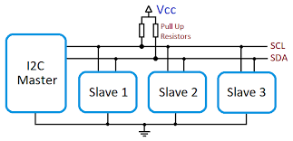

Cont~
I2C (Inter-Integrated Circuit): A serial communication protocol connecting multiple components that share the same bus lines. is a very cheap, yet effective, network used to interconnect peripheral devices within small-scale embedded systems. It is sometimes also known as IIC
Wi-Fi (Wireless Fidelity): Enabling microcontrollers to communicate wirelessly with other devices or networks, facilitating IoT applications and data transfer. Is good choice for IoT applications that need to transfer data to the cloud.
I2C
Wi-Fi
ES

Slide 18


Cont~
Bluetooth is a wireless technology that enables a wireless device to communicate in the 2.4 GHz industrial, scientific and medical (ISM) band. It has been specifically designed as a low cost, low power radio technology, which is particularly suited for the short range personal area network (PAN) application.
An RF module (short for radio-frequency module) is a (usually) small electronic device used to transmit and/or receive radio signals between two devices. In an embedded system it is often desirable to communicate with another device wirelessly.
Bluetooth
RF
ES

Slide 19
Common advantages of above components
Simplicity: easy to implement, requiring minimal hardware overhead.
Flexibility: allows for versatile system designs, accommodating a wide range of applications.
Wide Adoption: are widespread popularity, support and compatible devices available in the market.
Common disadvantages of above components
Limited Distance: most of all designed for short-distance (few meters).
ES

Slide 20
Thank you
for
your
attention

